Slide 1
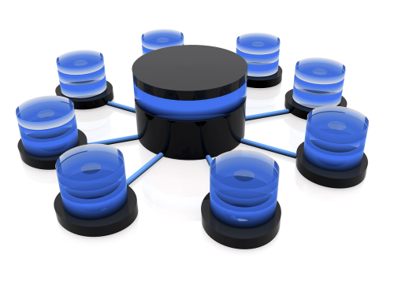
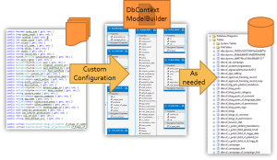
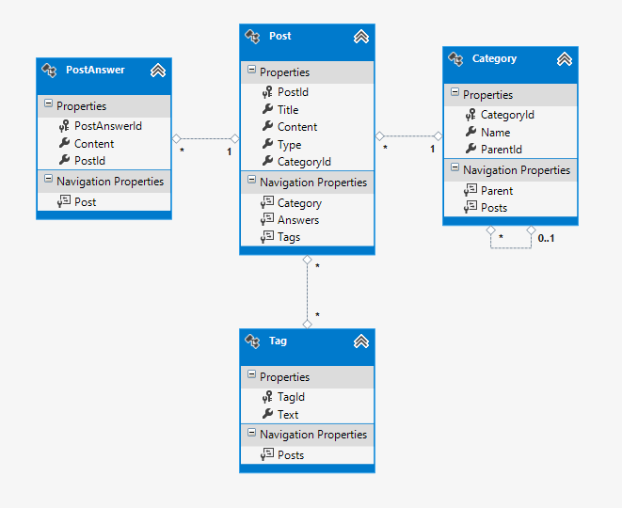
Entity Framework Code First
Telerik Academy
http://academy.telerik.com

Slide 2


Table of Contents
Modeling Workflow
Code First Main Parts
Domain Classes (Models)
DbContext and DbSets
Database connection
Using Code First Migrations
Configure Mappings
Working with Data
Entity Framework ++
LINQPad
Repository Pattern
Entity Framework Performance

Slide 3
Modeling Workflow
Entity Framework supports three types of modeling workflow:
Database first
Create models as database tables
Use Management Studio or native SQL queries
Model first
Create models using visual EF designer in VS
Code first
Write models and combine them in DbContext

Slide 4
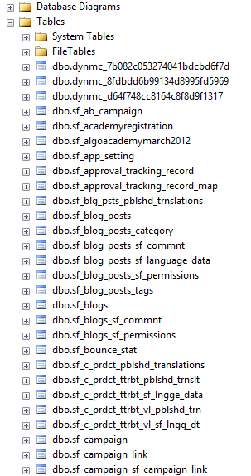
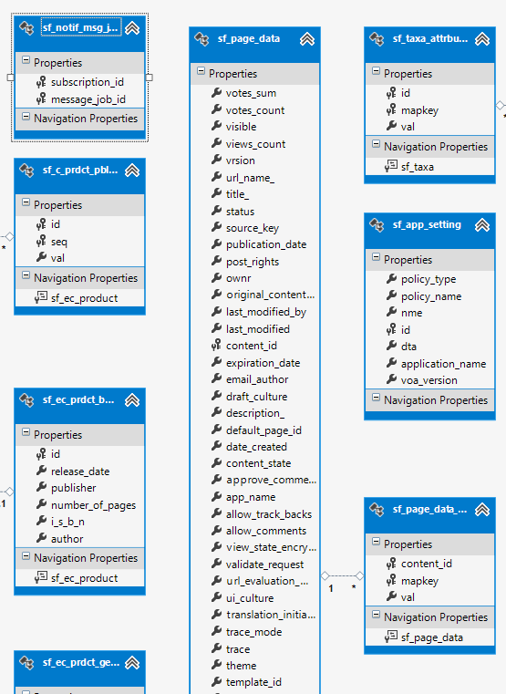
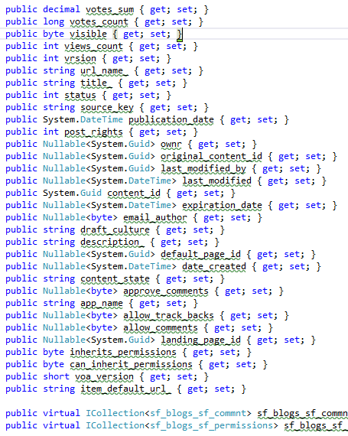
Database First Modeling Workflow
Create models as database tables and then generate code (models) from them

Slide 5
Model First Modeling Workflow

Slide 6
Code First Modeling Workflow
Domain classes
DbContext ModelBuilder
Custom Configuration
As needed

Slide 7
Why Use Code First?
Write code without having to define mappings in XML or create database models
Define objects in POCO
Reuse these models and their attributes
No base classes required
Enables database persistence with no configuration
Can use automatic migrations
Can use Data Annotations (Key, Required, etc.)

Slide 8

Code First Main Parts

Slide 9
Domain Classes (Models)
Bunch of normal C# classes (POCO)
May contain navigation properties
Recommended to be in a separate class library
Primary key
public class PostAnswer
{
public int PostAnswerId { get; set; }
public string Content { get; set; }
public int PostId { get; set; }
public virtual Post Post { get; set; }
}
Foreign key
Virtual for lazy loading
Navigation property

Slide 10
Domain Classes (Models) (2)
public class Post
{
private ICollection<PostAnswer> answers;
public Post()
{
this.answers = new HashSet<PostAnswer>();
}
// ...
public virtual ICollection<PostAnswer> Answers
{
get { return this.answers; }
set { this.answers = value; }
}
public PostType Type { get; set; }
}
Prevents null reference exception
Navigation property
Enumeration

Slide 11

Demo: Creating Models

Slide 12
DbContext Class
A class that inherits from DbContext
Manages model classes using DbSet type
Implements identity tracking, change tracking, and API for CRUD operations
Provides LINQ-based data access
Recommended to be in a separate class library
Don't forget to reference the Entity Framework library (using NuGet package manager)
If you have a lot of models it is recommended to use more than one DbContext

Slide 13
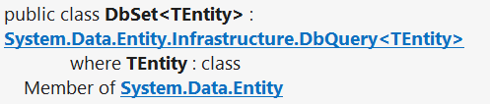
DbSet Type
Collection of single entity type
Set operations: Add, Attach, Remove, Find
Use with DbContext to query database
public DbSet<Post> Posts { get; set; }

Slide 14
DbContext Example
using System.Data.Entity;
using CodeFirst.Models;
public class ForumContext : DbContext
{
public DbSet<Category> Categories { get; set; }
public DbSet<Post> Posts { get; set; }
public DbSet<PostAnswer> PostAnswers { get; set; }
public DbSet<Tag> Tags { get; set; }
}

Slide 15
Demo: Creating DbContext

Slide 16
How to Interact With the Data?
In the same way as when we use database first or model first approach
var db = new ForumContext();
var category = new Category { Parent = null, Name = "Database course", };
db.Categories.Add(category);
var post = new Post();
post.Title = "Срока на домашните";
post.Content = "Моля удължете срока на домашните";
post.Type = PostType.Normal;
post.Category = category;
post.Tags.Add(new Tag { Text = "домашни" });
post.Tags.Add(new Tag { Text = "срок" });
db.Posts.Add(post);
db.SaveChanges();

Slide 17
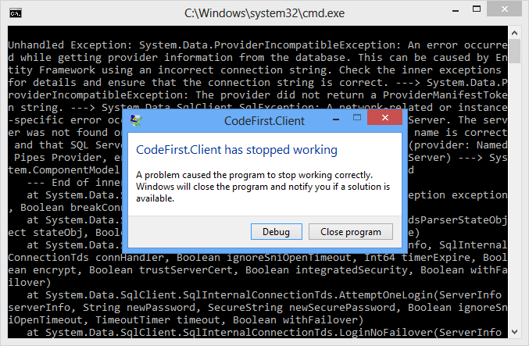
Demo: Using The Data

Slide 18
Where is My Data?
By default app.config file contains link to default connection factory that creates local db
Server name by default: (localdb)\v11.0 or .\SQLEXPRESS
We can use VS server explorer to view database
<entityFramework>
<defaultConnectionFactory type="System.Data.Entity.Infrastructure.LocalDbConnectionFactory, EntityFramework">
<parameters>
<parameter value="v11.0" />
</parameters>
</defaultConnectionFactory>
</entityFramework>

Slide 19
How to Connect to SQL Server?
First, create context constructor that calls base constructor with appropriate connection name
public class ForumContext : DbContext
{
public ForumContext()
: base("ForumDb")
{ }
// ...
}
Then add the connection string in app.config
Server address might be .\SQLEXPRESS
<connectionStrings>
<add name="ForumDb" connectionString="Data Source=.;Initial Catalog=ForumDb;Integrated Security=True" providerName="System.Data.SqlClient" />
</connectionStrings>

Slide 20
Database Connection Workflow
Connection String Available?
Database Exists?
Use Database
Build String (SQL Server Express or Create Local DB)
Create Database

Slide 21
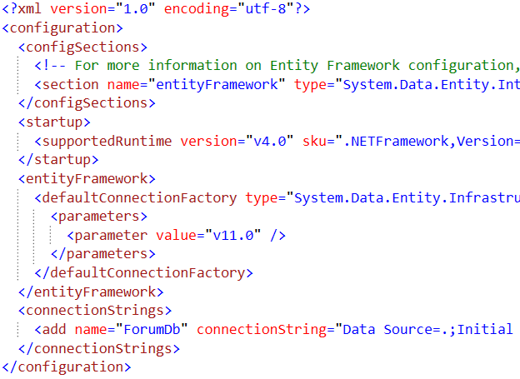
Demo: Change Database Connection

Slide 22

Using Code First Migrations

Slide 23

Changes in Domain Classes
What happens when we change our models?
Entity Framework compares our model with the model in __MigrationHistory table
By default Entity Framework only creates the database and don't do any changes after that
Using Code First Migrations we can manage differences between models and database

Slide 24
Code First Migrations
Enable Code First Migrations
Open Package Manager Console
Run Enable-Migrations command
This will create some initial jumpstart code
-EnableAutomaticMigrations for auto migrations
Two types of migrations
Automatic migrations
Set AutomaticMigrationsEnabled = true;
Code-based (providing full control)
Separate C# code file for every migration

Slide 25
Database Migration Strategies
CreateDatabaseIfNotExists (default)
DropCreateDatabaseIfModelChanges
We loose all the data when change the model
DropCreateDatabaseAlways
Great for automated integration testing
MigrateDatabaseToLatestVersion
This option uses our migrations
We can implement IDatabaseInitializer if we want custom migration strategy

Slide 26
Use Code First Migrations
First, enable code first migrations
Second, we need to tell to Entity Framework to use our migrations with code (or app.config)
We can configure automatic migration
Database.SetInitializer( new MigrateDatabaseToLatestVersion
<ForumContext, Configuration>());
This will allow us to delete or change properties
public Configuration()
{
this.AutomaticMigrationsEnabled = true;
this.AutomaticMigrationDataLossAllowed = true;
}

Slide 27
Seeding the Database
During a migration we can seed the database with some data using the Seed method
This method will be run every time (since EF 5)
protected override void Seed(ForumContext context)
{
/* This method will be called after migrating to
the latest version. You can use the
DbSet<T>.AddOrUpdate() helper extension method
to avoid creating duplicate seed data. E.g. */
context.Tags.AddOrUpdate(new Tag { Text = "срок" });
context.Tags.AddOrUpdate(new Tag { Text = "форум" });
}

Slide 28

Demo: Code First Migrations

Slide 29

Configure Mappings

Slide 30
Configure Mappings
Entity Framework respects mapping details from two sources
Data annotation attributes in the models
Can be reused for validation purposes
Fluent API code mapping configuration
By overriding OnModelCreating method
By using custom configuration classes
Use one approach or the other

Slide 31
Data Annotations
There is a bunch of data annotation attributes in System.ComponentModel.DataAnnotations
[Key] – specifies the primary key of the table
For validation: [StringLength], [MaxLength], [MinLength], [Required]
Schema: [Column], [Table], [ComplexType], [ComplexType], [InverseProperty], [ForeignKey], [DatabaseGenerated], [NotMapped], [Index]
In EF 6 we are able to add custom attributes by using custom conventions

Slide 32
Fluent API for Mappings
By overriding OnModelCreating method in DbContext class we can specify mapping configurations
protected override void OnModelCreating(DbModelBuilder modelBuilder)
{
modelBuilder.Entity<Tag>().HasKey(x => x.TagId);
modelBuilder.Entity<Tag>().Property(x => x.Text).IsUnicode(true);
modelBuilder.Entity<Tag>().Property(x => x.Text).HasMaxLength(255);
// modelBuilder.Entity<Tag>().Property(x => x.Text).IsFixedLength();
base.OnModelCreating(modelBuilder);
}

Slide 33
Fluent API Configurations
.Entity()
Map: Table Name, Schema
Inheritance Hierarchies, Complex Types
Entity -> Multiple Tables
Table -> Multiple Entities
Specify Key (including Composite Keys)
.Property()
Attributes (and Validation)
Map: Column Name, Type, Order
Relationships
Concurrency

Slide 34

Demo: Configure Mappings

Slide 35


Working with Data

Slide 36
Reading Data with LINQ Query
We can use extension methods (fluent API)
Find element by id
This is called
projection
using (var context = new NorthwindEntities())
{
var customerPhoness = context.Customers
.Select(c => c.Phone)
.Where(c => c.City == "London")
.ToList();
}
ToList() method executes the query
using (var context = new NorthwindEntities())
{
var customer = context.Customers.Find(2);
Console.WriteLine(customer.ContactTitle);
}

Slide 37
Logging the Native SQL Queries
To print the native database SQL commands executed on the server use the following:
var query = context.Countries;
Console.WriteLine(query.ToString());

Slide 38
Creating New Data
To create a new database row use the method Add(…) of the corresponding collection:
// Create new order object
Order order = new Order()
{
OrderDate = DateTime.Now, ShipName = "Titanic",
ShippedDate = new DateTime(1912, 4, 15),
ShipCity = "Bottom Of The Ocean"
};
// Mark the object for inserting
context.Orders.Add(order);
context.SaveChanges();
This will execute an SQL INSERT
SaveChanges() method call is required to post the SQL commands to the database

Slide 39
Cascading Inserts
We can also add cascading entities to the database:
Country spain = new Country();
spain.Name = "Spain";
spain.Population = "46 030 10";
spain.Cities.Add(new City { Name = "Barcelona"} );
spain.Cities.Add(new City { Name = "Madrid"} );
countryEntities.Countries.Add(spain);
countryEntities.SaveChanges();
This way we don't have to add each City individually
They will be added when the Country entity (Spain) is inserted to the database

Slide 40
Updating Existing Data
DbContext allows modifying entity properties and persisting them in the database
Just load an entity, modify it and call SaveChanges()
The DbContext automatically tracks all changes made on its entity objects
Order order = northwindEntities.Orders.First();
order.OrderDate = DateTime.Now;
context.SaveChanges();
This will execute an SQL UPDATE
This will execute an SQL SELECT to load the first order

Slide 41
Deleting Existing Data
Delete is done by Remove() on the specified entity collection
SaveChanges() method performs the delete action in the database
Order order = northwindEntities.Orders.First();
// Mark the entity for deleting on the next save
northwindEntities.Orders.Remove(order);
northwindEntities.SaveChanges();
This will execute an SQL DELETE command

Slide 42



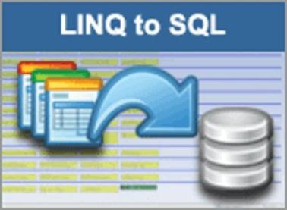


Demo: CRUD Operations with Entity Framework

Slide 43
Entity Framework ++

Slide 44
Entity Framework
EntityFramework is not perfect
Slow inserts, no update without selecting the entity, no delete by predicate
You can use
EntityFramework.Extended - https://github.com/loresoft/EntityFramework.Extended
EntityFramework.Utilities - https://github.com/MikaelEliasson/EntityFramework.Utilities
Performance test
http://blog.credera.com/technology-insights/microsoft-solutions/entity-framework-batch-operations-using-ef-utilities/

Slide 45

LINQPad

Slide 46
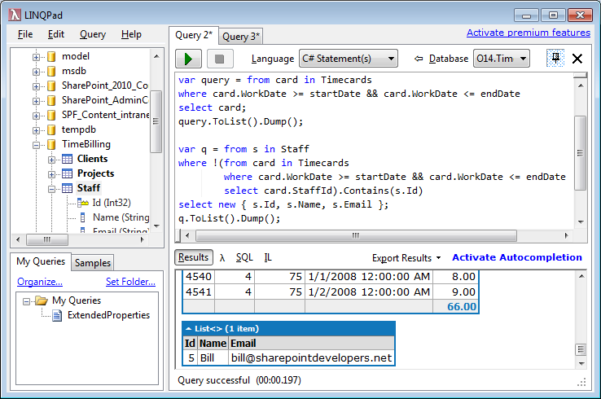
LINQPad
Download from: http://www.linqpad.net/
Supports native C# 5.0
Translates it to SQL, XML, Objects
Understands LINQ
Free and paid version

Slide 47
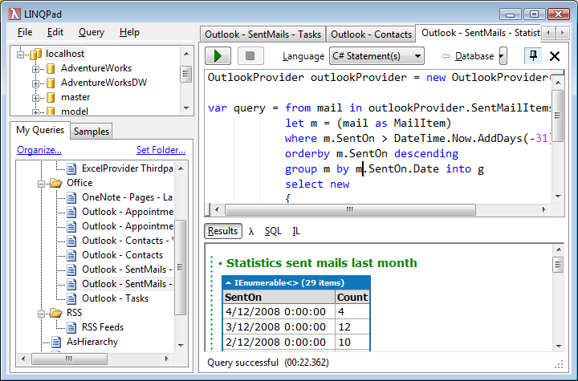
Demo: LINQ Pad

Slide 48
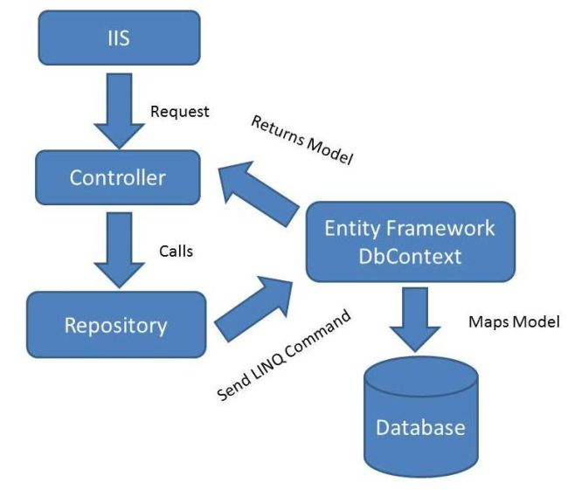
Repository Pattern

Slide 49
Repository Pattern
Gives abstraction over the data layer
Single place to make changes to your data access
Single place responsible for a set of tables
Easily replaceable by other implementations
Hides the details in accessing data
Can be implemented in various ways

Slide 50


Demo: Repository Pattern

Slide 51
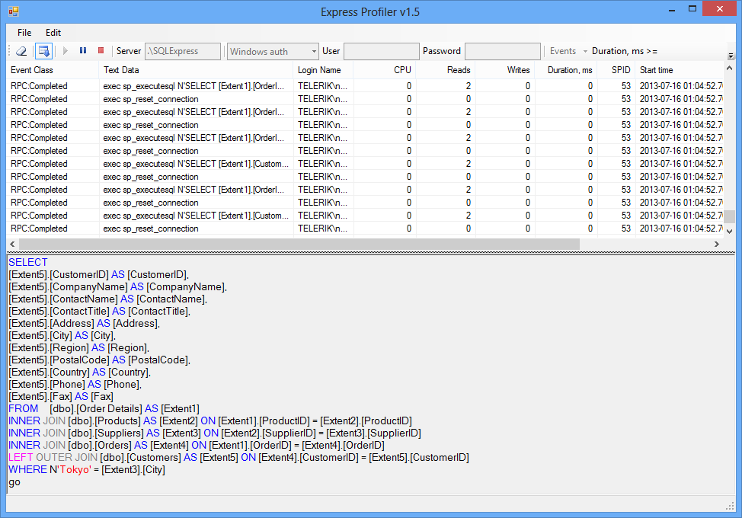
SQL Profilers

Slide 52
What is SQL Profiler?
SQL Profilers intercept the SQL queries executed at the server side
Powerful tools to diagnose the hidden Entity Framework queries
SQL Server has "SQL Server Profiler" tool
Part of Enterprise / Developer edition (paid tool)
A free SQL Profiler exists for SQL Server:
Express Profiler: http://expressprofiler.codeplex.com
Easy-to-use, open-source, lightweight, powerful, … and works!

Slide 53
Demo: SQL Profiler

Slide 54
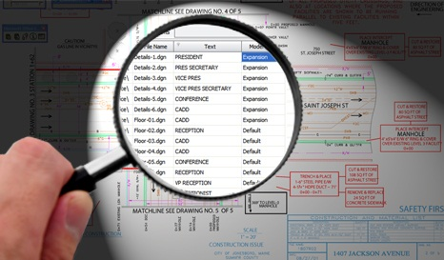
The N+1 Query Problem

Slide 55
The N+1 Query Problem
What is the N+1 Query Problem?
Imagine a database that contains tables Products, Suppliers and Categories
Each product has a supplier and a category
We want to print each Product along with its Supplier and Category:
foreach (var product in context.Products)
{
Console.WriteLine("Product: {0}; {1}; {2}",
product.ProductName, product.Supplier.CompanyName,
product.Category.CategoryName);
}

Slide 56
The N+1 Query Problem (2)
This code will execute N+1 SQL queries:
Imagine we have 100 products in the database
That's ~ 201 SQL queries → very slow!
We could do the same with a single SQL query
One query to retrive the products
foreach (var product in context.Products)
{
Console.WriteLine("Product: {0}; {1}; {2}",
product.ProductName, product.Supplier.CompanyName,
product.Category.CategoryName);
}
Additional N queries to retrieve the supplier for each product
Additional N queries to retrieve the category for each product

Slide 57
Solution to the N+1 Query Problem
Fortunately there is an easy way in EF to avoid the N+1 query problem:
Using Include(…) method only one SQL query with join is made to get the related entities
foreach (var product in context.Products.
Include(p => p.Supplier).Include(p => p.Category))
{
Console.WriteLine("Product: {0}; {1}; {2}",
product.ProductName, product.Supplier.CompanyName,
product.Category.CategoryName);
}
No additional SQL queries are made here for the related entities

Slide 58

Solution to the N+1 Query Problem

Slide 59

Incorrect Use of ToList()

Slide 60
Incorrect Use of ToList()
In EF invoking ToList() executes the underlying SQL query in the database
Transforms IQueryable<T> to List<T>
Invoke ToList() as late as possible, after all filtering, joins and groupings
Avoid such code:
This will cause all order details to come from the database and to be filtered later in the memory
List<Order_Detail> orderItemsFromTokyo =
northwindEntities.Order_Details.ToList().
Where(od => od.Product.Supplier.City == "Tokyo").ToList();

Slide 61
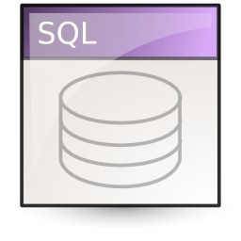
Demo: Incorrect Use of ToList()

Slide 62
Incorrect Use of SELECT *

Slide 63
Deleting Entities Faster with Native SQL Query

Slide 64
Deleting Entities
Deleting entities (slower):
Executes SELECT + DELETE commands
Deleting entities with native SQL (faster):
Executes a single DELETE command
NorthwindEntities northwindEntities = new NorthwindEntities();
var category = northwindEntities.Categories.Find(46);
northwindEntities.Categories.Remove(category);
northwindEntities.SaveChanges();
NorthwindEntities northwindEntities = new NorthwindEntities();
northwindEntities.Database.ExecuteSqlCommand(
"DELETE FROM Categories WHERE CategoryID = {0}", 46);

Slide 65
Deleting Entities Faster with Native SQL Query

Slide 66
Performance optimization
You can remove some of the default options
public DbContext()
{
this.Configuration.AutoDetectChangesEnabled = false;
this.Configuration.LazyLoadingEnabled = false;
this.Configuration.ProxyCreationEnabled = false;
this.Configuration.ValidateOnSaveEnabled = false;
}

Slide 67
Entity Framework Code First
http://academy.telerik.com

Slide 68
Workshop
Using code first approach, create database for a forum system with the following tables:
Forum Posts – title, content, author, date created, views, tags, category
Questions and answers should be the same database type
Forum Categories – title, description, posts, URL
Forum Tags – title, posts
Write a console application that uses the data
Seed the data with random values

